Slide 1
CS 316: Introduction to Deep Learning
Language Models - RNN
Dr Abdul Samad

Slide 2


Modeling Language
Tokens not real values (domain is countably finite)
Estimating it
Notes:
. Suppose that we tokenize text data at the word level.
. The number of all unique tokens are called vocabulary
. Estimation becomes very difficult task when the T grows, because we may not have n-grams

Slide 3
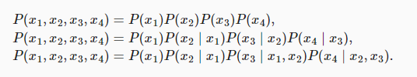
Markov models
Unigram, bigram, trigram

Slide 4
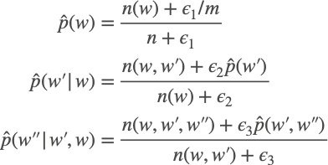
N-grams (longer sequences of tokens)
Need smoothing (long n-grams are infrequent)
Talk to your friendly Bayesian if you want to do it right!
Notes:
Unfortunately, models like this get unwieldy rather quickly for the following reasons. First, as discussed in Section 9.2.5, many n-grams occur very rarely, making Laplace smoothing rather unsuitable for language modeling. Second, we need to store all counts. Third, this entirely ignores the meaning of the words. For instance, “cat” and “feline” should occur in related contexts. It is quite difficult to adjust such models to additional contexts, whereas, deep learning based language models are well suited to take this into account. Last, long word sequences are almost certain to be novel, hence a model that simply counts the frequency of previously seen word sequences is bound to perform poorly there.
Denote by n the total number of words in the training set and m the number of unique words.

Slide 5

Perplexity
3 sentences generated by the models
“It is raining outside”
“It is raining banana tree”
“It is raining piouw;kcj pwepoiut”
Always predicts correct or wrong or uniform distribution?
Notes:
where P is given by a language model and xt is the actual token observed at time step t from the sequence.
In the best case scenario, the model always perfectly estimates the probability of the target token as 1. In this case the perplexity of the model is 1.
In the worst case scenario, the model always predicts the probability of the target token as 0. In this situation, the perplexity is positive infinity.
At the baseline, the model predicts a uniform distribution over all the available tokens of the vocabulary. In this case, the perplexity equals the number of unique tokens of the vocabulary. In fact, if we were to store the sequence without any compression, this would be the best we could do to encode it. Hence, this provides a nontrivial upper bound that any useful model must beat.

Slide 6
Text Preprocessing

Slide 7
Tokenization
The Time Machine by H. G. Wells
Basic Idea - map text into sequence of IDs
Character Encoding (each character has one ID)
Small vocabulary
Doesn’t work so well
Word Encoding (each word has one ID)
Accurate spelling
Doesn’t work so well
Byte Pair Encoding (Goldilocks zone)
Frequent subsequences (like syllables)

Slide 8
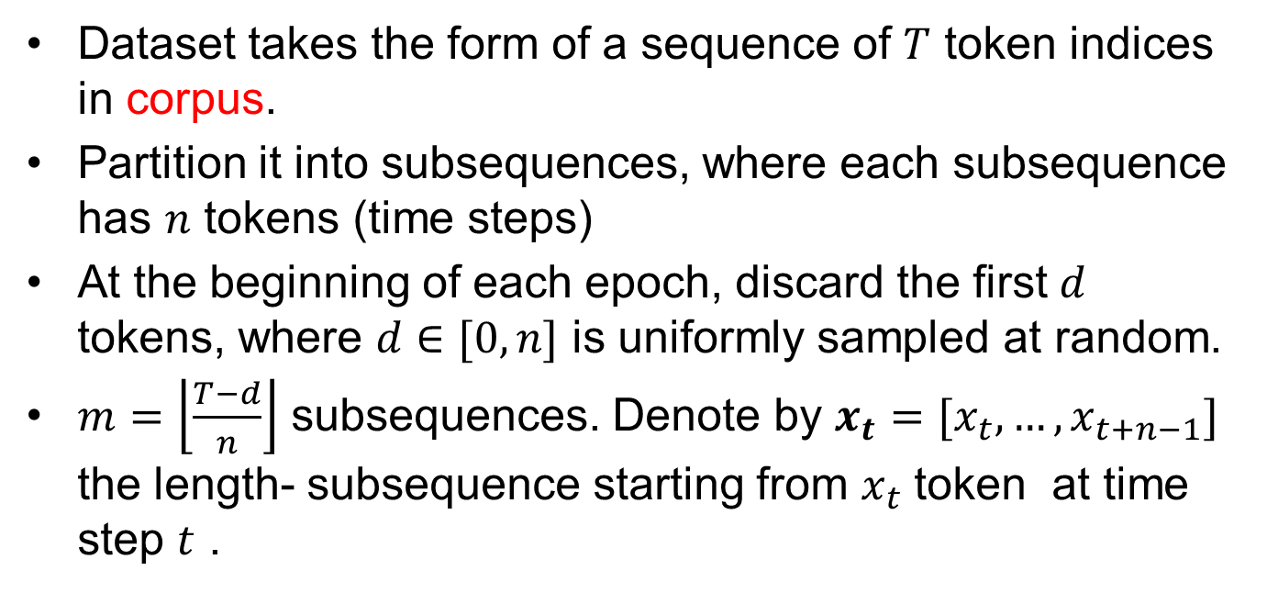
Partitioning sequences

Slide 9
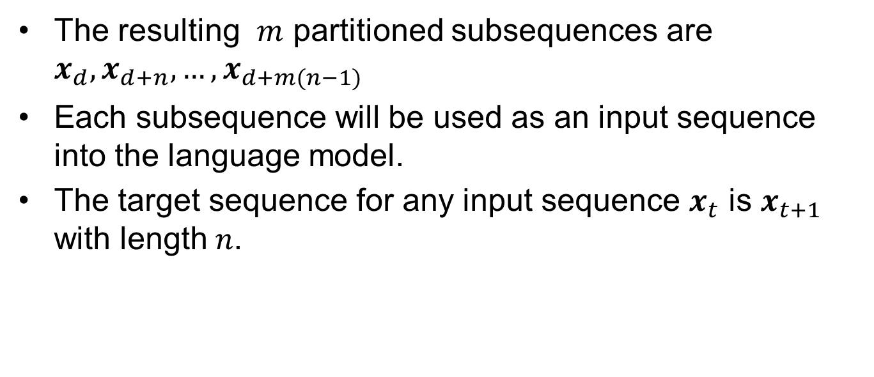
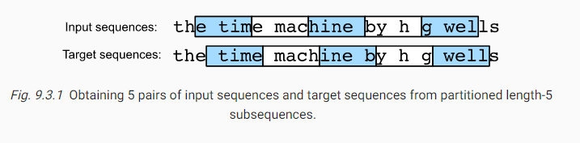
Partitioning sequences

Slide 10
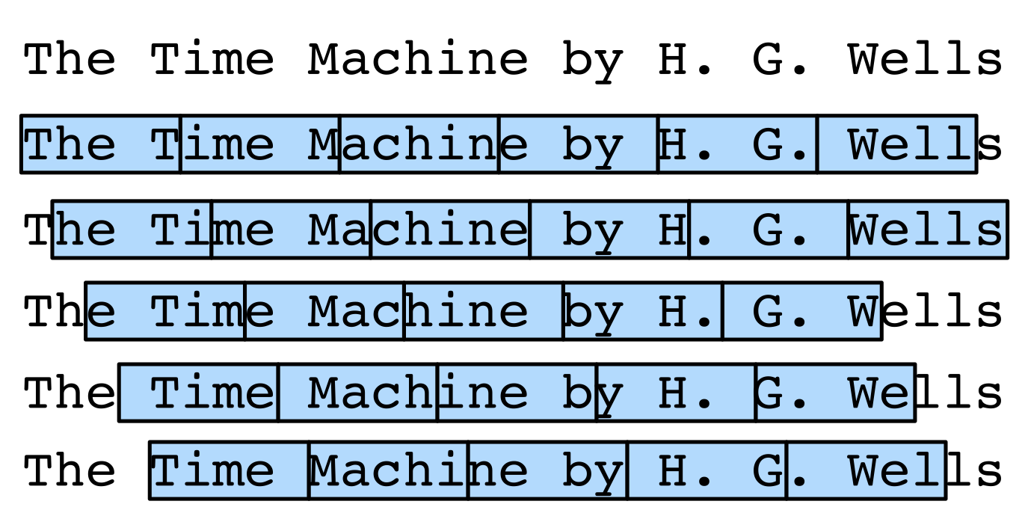
Minibatch Generation

Slide 11
Minibatch Generation
Sequential partitioning
Pick random offset
Distribute sequences in sequence over mini batches
Dependent samples

Slide 12

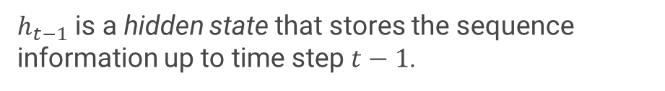

RNN
Notes:
If we want to incorporate the possible effect of tokens earlier than time step t−(n−1) on xt, we need to increase n. However, the number of model parameters would also increase exponentially with it, as we need to store |V|n numbers for a vocabulary set V. Hence, rather than modeling P(xt∣xt−1,…,xt−n+1) it is preferable to use a latent variable model:
ht−1 is a hidden state that stores the sequence information up to time step t−1.

Slide 13
Recurrent Neural Networks (with hidden state)
Hidden State update
Observation update

Slide 14
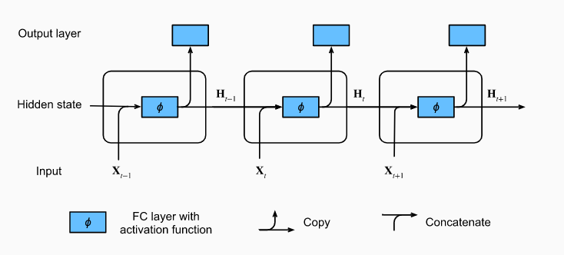
RNN

Slide 15
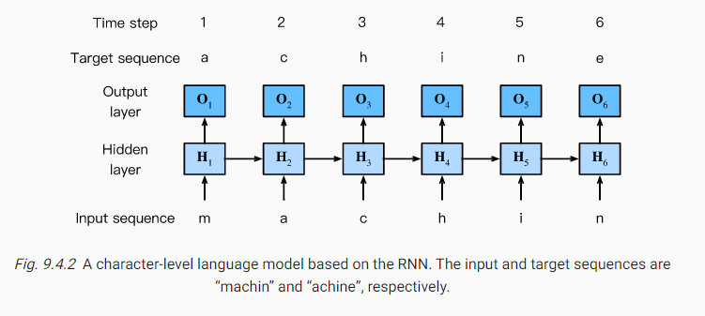
Character Level RNN

